Slide 1
The Real World of Money
For the purposes of this activity, please imagine
that you have finished your educational journey and
have just moved out of your parents’ house.
Maybe you are 18.
Maybe you are 22.
Maybe you are 25.
In any case, you are now officially ‘on your own’ !
Congratulations! (I think)
Copyright © 2012 Chad Foster

Slide 2
Money
Make it.
Manage it.
Multiply it.
Protect it.

Slide 3
Four Ways to Get Money

Slide 4
Earn It!

Slide 5
Marry
It!

Slide 6
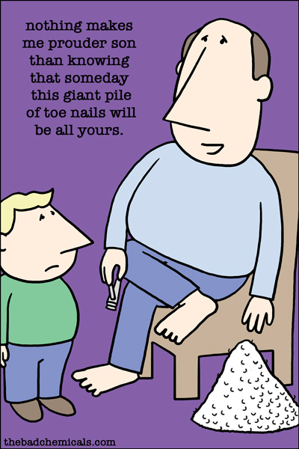
Inherit
It!

Slide 7
Steal It!
t

Slide 8
Stuff
Do I Need It?
or
Do I Just Want It?

Slide 9
How much does it really cost to live in the Real World?
Housing
Transportation
Mixed Bag
Leisure
Day to Day

Slide 10
reality
Definition: the state of things as they actually are rather than as they might be imagined.

Slide 11
Starting Line
Grab your Real World of Money Spending Plan Worksheet and get ready to make a few ‘lifestyle’ choices.
This activity will help you understand the real cost of
living on your own. That wisdom will then help you
prepare for your inevitable entry into the real world.
You make the call…you pay the price!

Slide 12
.
Life is All
About Choices…

Slide 13
Housing: a shelter in which people live

Slide 14
Housing
Rent or Buy?
Insurance and Taxes
Utilities
Repairs and Maintenance
Surprise Expenses

Slide 15
Housing Rent or Buy?
Option 1 – Rent 2-bedroom apartment with roommate
Cost: $550 per month
Option 2 – Rent 2-bedroom apartment without roommate
Cost: $1,100 per month
Option 3 – Purchase 2-bedroom house - Price: $117,500
Cost: $628 per month (for 30 years!)
Option 4 – Purchase 3-bedroom house - Price: $247,400
Cost: $1,328 per month (for 30 years!)
Please note your option selection/cost on your
Spending Plan Worksheet and proceed to next slide.

Slide 16
Important
Whichever option number
you just chose as your ‘Rent or Buy?’
Housing Option # on the previous slide will be your Option # for every
slide for the rest of this activity.

Slide 17
Housing Insurance / Taxes
Option 1 – Cost: $12 per month for Renters Insurance
Option 2 – Cost: $24 per month for Renters Insurance
Option 3 – Cost: $37 per month for homeowners/fire insurance
Cost: $108 per month for property taxes
Option 4 – Cost: $46 per month for homeowners/fire insurance
Cost: $220 per month for property taxes
Please note your option selection/cost on your
Spending Plan Worksheet and proceed to next slide.

Slide 18
Did You Know??
If you rent an apartment, dorm, house
or trailer, you will lose everything
you own if the place burns down…
unless you have Renter’s Insurance.

Slide 19
Housing Utilities (water, electricity, gas)
Option 1 – Cost: $65 per month
Option 2 – Cost: $130 per month
Option 3 – Cost: $143 per month
Option 4 – Cost: $155 per month
Please note your option selection/cost on your
Spending Plan Worksheet and proceed to next slide.

Slide 20
Housing Repairs / Maintenance
Option 1 – Cost $20 per month
Option 2 – Cost: $40 per month
Option 3 – Cost: $175 per month
Option 4 – Cost: $245 per month
Please note your option selection/cost on your
Spending Plan Worksheet and proceed to next slide.

Slide 21
Did You Know??
If you have to hire a plumber to fix a
stopped-up toilet, you just flushed a
quick $100 down the drain!

Slide 22
Housing Surprise Household Expenses
Option 1 – Cost $40 per month
Option 2 – Cost: $80 per month
Option 3 – Cost: $130 per month
Option 4 – Cost: $175 per month
Please note your option selection/cost on your
Spending Plan Worksheet and proceed to next slide.

Slide 23
Do you know what a Surprise Expense is??
Can’t tell you. If we did then
it wouldn’t be a SURPRISE!

Slide 24
Home Sweet Home! Please use your Spending Plan Worksheet to complete the required information below.
HOUSING | You Make the Call Option # Selected | You Pay the Price! Monthly Cost
Rent or Mortgage Payment
Insurance and Taxes
Utilities, Telephone, Cable
Repairs and Maintenance
Surprise Expenses
Total for Housing |  | $

Slide 25
and more choices…

Slide 26
Leisure: free time for enjoyment

Slide 27
Leisure and Entertainment
Home Entertainment
Vacation and Travel
Hobbies

Slide 28
Leisure and Entertainment Home Entertainment – (Internet, TV, cell phone)
Option 1 – Cost: $90 per month
Option 2 – Cost: $115 per month
Option 3 – Cost: $135 per month
Option 4 – Cost: $145 per month
Please note your option selection/cost on your
Spending Plan Worksheet and proceed to next slide.

Slide 29
Did You Know??
Satellite TV with just a few extra
features can easily cost $75 per month!

Slide 30
Leisure and Entertainment Vacation and Travel
Option 1 – Cost: $120 per month
Option 2 – Cost: $150 per month
Option 3 – Cost: $195 per month
Option 4 – Cost: $215 per month
Please note your option selection/cost on your
Spending Plan Worksheet and proceed to next slide.

Slide 31
Leisure and Entertainment Hobbies
Option 1 – Cost: $80 per month
Option 2 – Cost: $80 per month
Option 3 – Cost: $115 per month
Option 4 – Cost: $145 per month
Please note your option selection/cost on your
Spending Plan Worksheet and proceed to next slide.

Slide 32
Nothing But Fun! Please use your Spending Plan Worksheet to complete the required information below.
LEISURE AND ENTERTAINMENT | You Make the Call Option # Selected | You Pay the Price! Monthly Cost
Home Entertainment
Vacation and Travel
Hobbies
Total for Leisure and Entertainment |  | $

Slide 33
and more choices…

Slide 34
Mixed Bag: an assortment of items

Slide 35
Mixed Bag of Expenses
Savings and Investments
Credit Payments
Gifts
Charitable Donations
Unexpected Expenses

Slide 36
Mixed Bag of Expenses Retirement, Savings, Investments
Option 1 – Cost: $220 per month
Option 2 – Cost: $220 per month
Option 3 – Cost: $320 per month
Option 4 – Cost: $400 per month
Please note your option selection/cost on your
Spending Plan Worksheet and proceed to next slide.

Slide 37
Did You Know??
If you save/invest $50 per month
starting at age 18, it could be
worth $400,000 when you retire!

Slide 38
Mixed Bag of Expenses Credit Payments (student loans, credit cards)
Option 1 – Cost: $120 per month
Option 2 – Cost: $120 per month
Option 3 – Cost: $185 per month
Option 4 – Cost: $240 per month
Please note your option selection/cost on your
Spending Plan Worksheet and proceed to next slide.

Slide 39
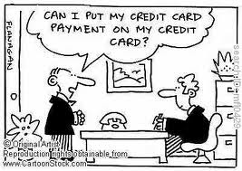
Did You Know??
If you spend $1,000 on your credit card and then make the terrible decision to pay just the minimum payment each month, it could take you 20 years to pay off that credit card!

Slide 40
Mixed Bag of Expenses Gifts (for yourself and others!)
Option 1 – Cost: $65 per month
Option 2 – Cost: $65 per month
Option 3 – Cost: $105 per month
Option 4 – Cost: $125 per month
Please note your option selection/cost on your
Spending Plan Worksheet and proceed to next slide.

Slide 41
Mixed Bag of Expenses Donations/Contributions
Option 1 – Cost: $75 per month
Option 2 – Cost: $75 per month
Option 3 – Cost: $130 per month
Option 4 – Cost: $185 per month
Please note your option selection/cost on your
Spending Plan Worksheet and proceed to next slide.

Slide 42
Did You Know??
No matter who you are, what you have or don’t
have, there will always be someone out there who
has less and who needs help. Giving is important!

Slide 43
Mixed Bag of Expenses Unexpected Expenses
Option 1 – Cost: $120 per month
Option 2 – Cost: $120 per month
Option 3 – Cost: $185 per month
Option 4 – Cost: $200 per month
Please note your option selection/cost on your
Spending Plan Worksheet and proceed to next slide.

Slide 44
Mixed Bag of Expenses Please use your Spending Plan Worksheet to complete the required information below.
MIXED BAG EXPENSES | You Make the Call Option # Selected | You Pay the Price! Monthly Cost
Retirement , Savings, Investments
Credit Payments
Gifts
Donations
Expect the Unexpected
Total for Mixed Bag of Expenses |  | $

Slide 45
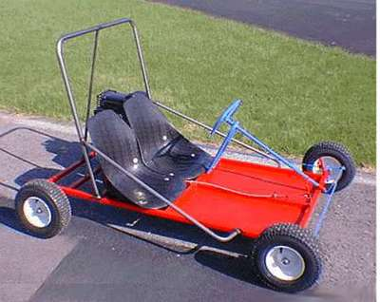
and more
choices…

Slide 46
Transportation: the state of being transported

Slide 47
Transportation
Down Payment / Taxes
Loan Payment
Insurance
Gas and Oil
Repairs and Maintenance

Slide 48
Transportation Down Payment/Taxes
Option 1 – Cost: $250 per month
Option 2 – Cost: $250 per month
Option 3 – Cost: $280 per month
Option 4 – Cost: $315 per month
Please note your option selection/cost on your
Spending Plan Worksheet and proceed to next slide.

Slide 49
Did You Know??
If you purchase a $20,000 vehicle, you
will need to add approximately $1,400
to the price for sales tax.

Slide 50
Transportation Loan Payment
Option 1 – Cost: $265 per month
Option 2 – Cost: $265 per month
Option 3 – Cost: $345 per month
Option 4 – Cost: $385 per month
Please note your option selection/cost on your
Spending Plan Worksheet and proceed to next slide.

Slide 51
Transportation Insurance
Option 1 – Cost: $180 per month
Option 2 – Cost: $180 per month
Option 3 – Cost: $220 per month
Option 4 – Cost: $240 per month
Please note your option selection/cost on your
Spending Plan Worksheet and proceed to next slide.

Slide 52
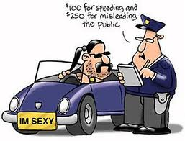
Did You Know??
If you get one speeding ticket,
your auto insurance could go
up as much as $50 per month.
That’s a cool $600 per year!

Slide 53
Transportation Gas and Oil
Option 1 – Cost: $200 per month
Option 2 – Cost: $200 per month
Option 3 – Cost: $220 per month
Option 4 – Cost: $245 per month
Please note your option selection/cost on your
Spending Plan Worksheet and proceed to next slide.

Slide 54
Did You Know??
With gas at $3.50 per gallon, every mile
you drive will cost almost 20 cents.

Slide 55
Transportation Repairs and Maintenance
Option 1 – Cost: $150 per month
Option 2 – Cost: $150 per month
Option 3 – Cost: $200 per month
Option 4 – Cost: $275 per month
Please note your option selection/cost on your
Spending Plan Worksheet and proceed to next slide.

Slide 56
Did You Know??
A set of new tires on your
car/truck can cost $500!

Slide 57
The Deal on Wheels! Please use your Spending Plan Worksheet to complete the required information below.
TRANSPORTATION | You Make the Call Option # Selected | You Pay the Price! Monthly Cost
Down Payment / Taxes
Loan Payment
Insurance
Gas / Oil
Repairs / Maintenance
Total for Transportation |  | $

Slide 58
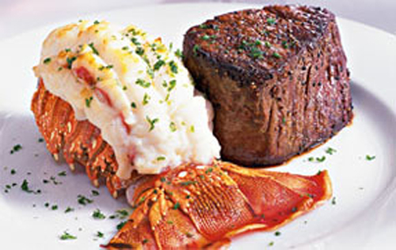
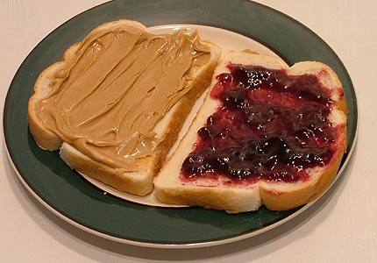
and more
choices…

Slide 59
Daily Expenses: the daily cost of living

Slide 60
Day to Day
Groceries / Dining Out
Insurance
Clothing / Personal Care
Medical Bills

Slide 61
Day to Day Groceries / Dining Out
Option 1 – Cost: $300 per month
Option 2 – Cost: $350 per month
Option 3 – Cost: $450 per month
Option 4 – Cost: $550 per month
Please note your option selection/cost on your
Spending Plan Worksheet and proceed to next slide.

Slide 62
Did You Know??
Gallon of Milk - $3.45
Laundry Detergent - $10.67
Gallon of Ice Cream - $5.28

Slide 63
Day to Day Insurance (health, life, disability)
Option 1 – Cost: $275 per month
Option 2 – Cost: $275 per month
Option 3 – Cost: $320 per month
Option 4 – Cost: $375 per month
Please note your option selection/cost on your
Spending Plan Worksheet and proceed to next slide.

Slide 64
Did You Know??
If you get sick or injured and can’t
work you still have to pay your rent, car
note, student loans, etc. If you don’t pay, you
could go bankrupt… unless you have disability insurance.

Slide 65
Day to Day Clothing and Personal Care (make-up, haircut, etc.)
Option 1 – Cost: $185 per month
Option 2 – Cost: $185 per month
Option 3 – Cost: $235 per month
Option 4 – Cost: $285 per month
Please note your option selection/cost on your
Spending Plan Worksheet and proceed to next slide.

Slide 66
Did You Know??
Men’s Haircut - $18
Women’s Cut and Color - $85

Slide 67
Day to Day Medical Bills / Prescriptions
Option 1 – Cost: $75 per month
Option 2 – Cost: $75 per month
Option 3 – Cost: $120 per month
Option 4 – Cost: $175 per month
Please note your option selection/cost on your
Spending Plan Worksheet and proceed to next slide.

Slide 68
Day to Day Expenses Please use your Spending Plan Worksheet to complete the required information below.
Day to Day Expenses | You Make the Call Option # Selected | You Pay the Price! Monthly Cost
Groceries
Insurance
Clothing / Personal Care
Medical Bills / Prescriptions
Total for Day to Day Expenses |  | $

Slide 69
Now What?
1. Add up your category totals to see what
your total monthly expenses are
based on the selections you made.
Housing $ + Leisure $ + Mixed Bag $ + Transportation $ + Day to Day $
=
Monthly ‘Cost of Living’ (C.O.L.)
2. Multiply your monthly C.O.L. by 12 to determine
what your annual income (after income taxes) will
need to be in order to pay for your lifestyle choices.
Monthly ‘Cost of Living’x 12 = Annual Cost of Living

Slide 70
Finish Line!
Facts about Finances
As you get older, your needs and wants will change.
As you get older, your income will probably increase.
As you get older, you might have a family to support.
When you’re really old, you better have some cash stashed!

Slide 71
The Bottom Line
A few people retire at age 40.
Most people work until they are 67 years old.
Some people have to work until the day they die.
How you make, manage, multiply, and protect your hard-
earned money determines into which category you will fall.
Good Luck in the Real World of Money!

Slide 72
For More Information
Chad Foster
chadwfoster@att.net
www.chadfoster.com
Copyright © 2013 Chad Foster

